Slide 1
Medical terminology
Chapter 1

Slide 2
Medical Terminology
The words or terms which make up the language of medicine are referred to as the terminology of the medical field
When you understand the structure of medical terms , you can decode the terms into their parts and derived the meaning quite easily

Slide 3
Origin of medical terms
Most of medical terms are based on either Greek or Latin words
Like every other language , medical terminology has changed over time and will continue to change

Slide 4
Importance of the medical terminology
Simplify communication /break down the language barrier
Easy understanding (common language )
They are specific terminologies, thus makes no need to use general terminology

Slide 5
Word analysis
The medical words contains all or some of these
Word root
Suffixes
Prefixes
Combining form
Prefixes / Roots /Suffixes

Slide 6
Word root
A root is the basic element of a word , and it is the foundation on which the meaning of a word is built
Roots come from many different languages
All medical terms have at least one word root

Slide 7
Prefix
A prefix is a word component placed in front of a root to change or modify its meaning
A prefix can give a root direction or position . It can also give a root a specific type /classification, quality or quantity

Slide 8
Suffix
A suffix is a word component added to the end of a root that changes or modifies it usage, function or meaning

Slide 9
Combining form
Combining (linking )forms
  Word root is combined with a vowel
Usually “O” but occasionally “e” or “I”
Combined form =word root + O

Slide 10
Notes:
(A, I, O, U, E)

Slide 11
When you analyze a medical term, begin at the end of the word
Letter O, has no meaning but is an important connector between the root and the suffix

Slide 12
The combining vowel plus the root is called a combining form
Notes:
Muscle contraction to pump blood
Heartbeat
The combining vowel plus the root is called a combining form

Slide 13
ELECTR/0/CARDI/O/GRAM
It is the electrical current flowing within the heart that causes the heart muscle to contract, pumping blood throughout the body
The sound made by contraction and relaxation of the heart muscle is called the heartbeat

Slide 14
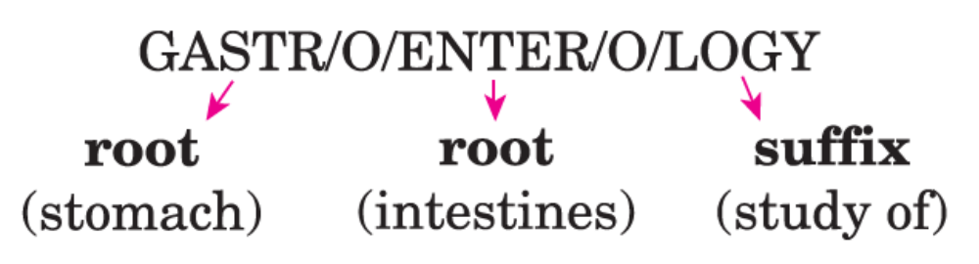

Slide 16
Drop of Combining Vowel
Words ending with –IC/ –AC are adjectives that modify a noun
Notes:
Notice that the combining vowel is dropped when the suffix (-IC) begins with a vowel.

Slide 17

The combining vowel (O) is dropped when the suffix (-AC) begins with a vowel

Slide 18
Combining vowel (O) is dropped because the suffix (-ITIS) begins with a vowel

Slide 19
Combining vowel (O) remains between the two roots here, even though the second root (ENTER) begins with a vowel

Slide 24
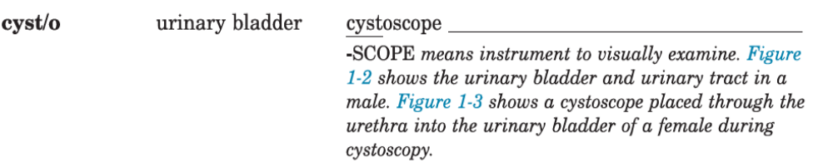

Slide 26
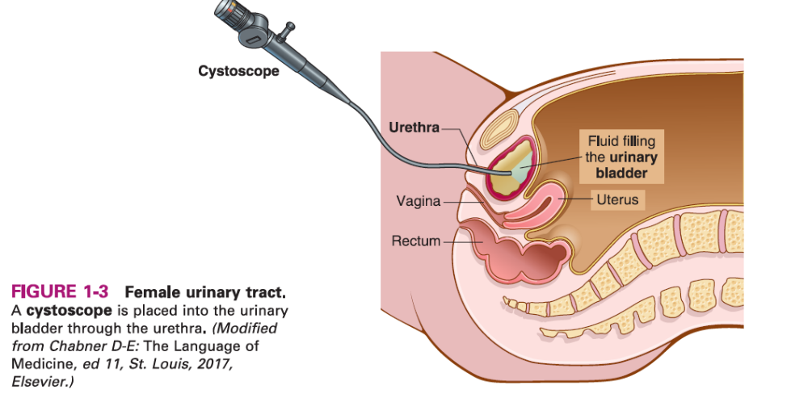

Slide 29
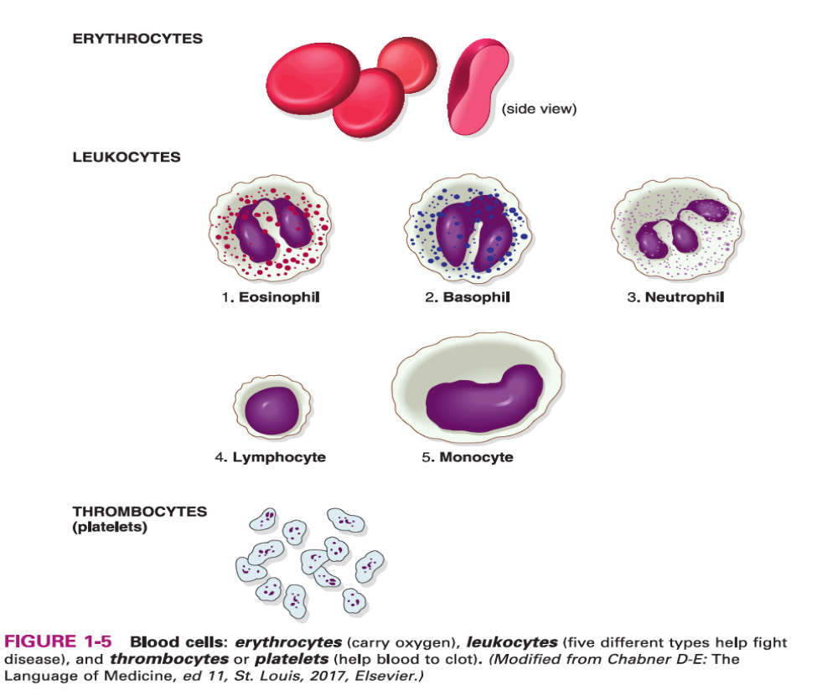

Slide 31
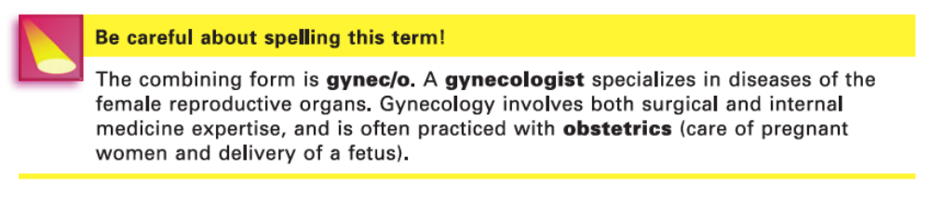

Slide 37
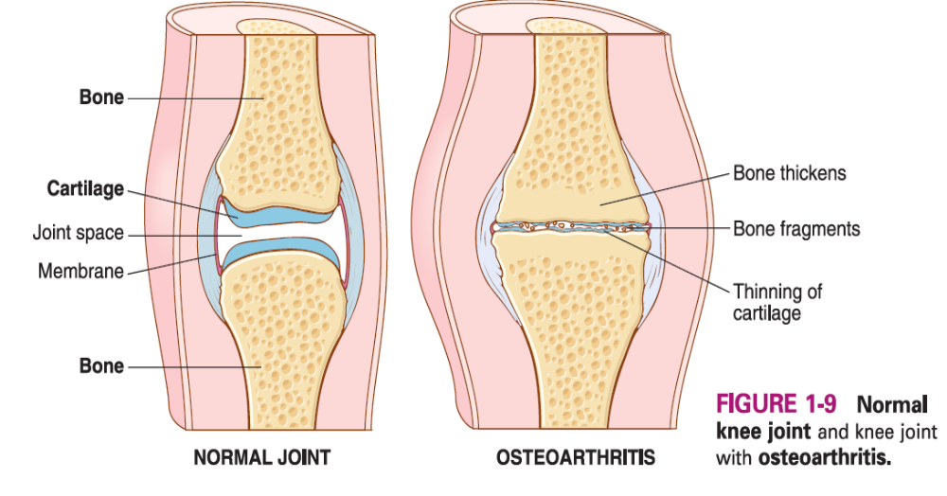

Slide 38
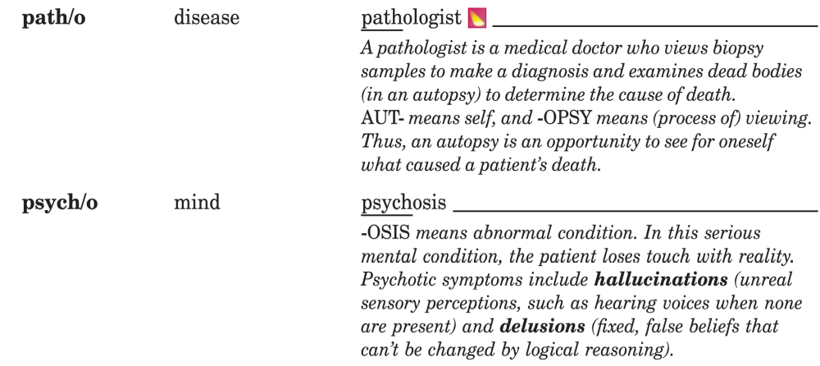
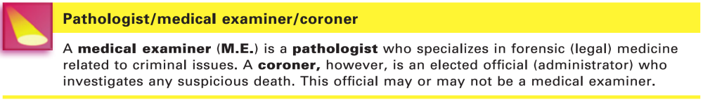

Slide 39
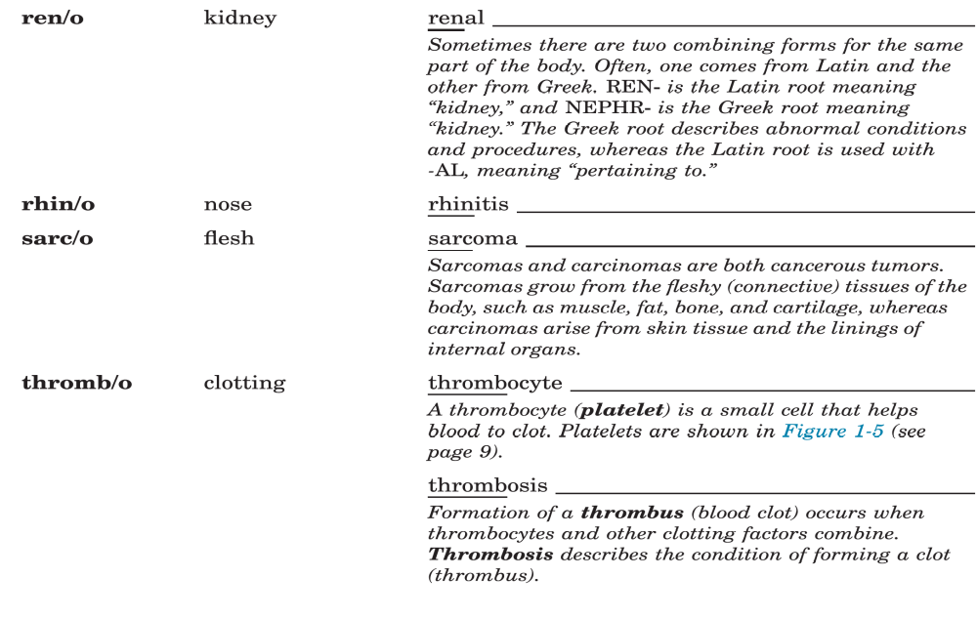

Slide 41
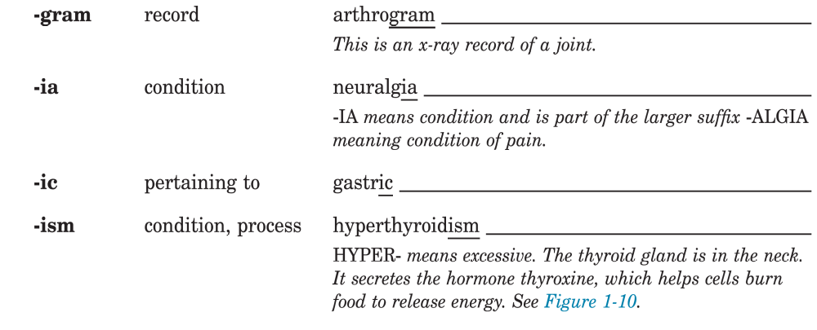

Slide 43
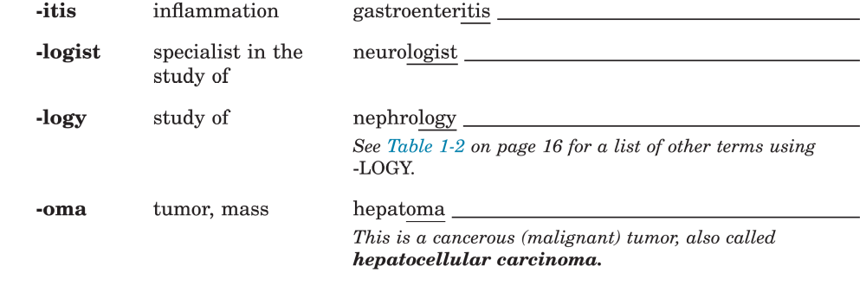
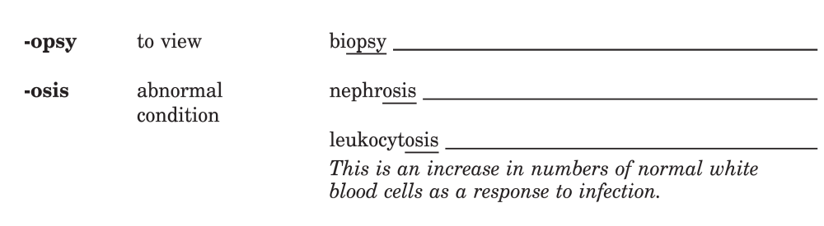

Slide 44
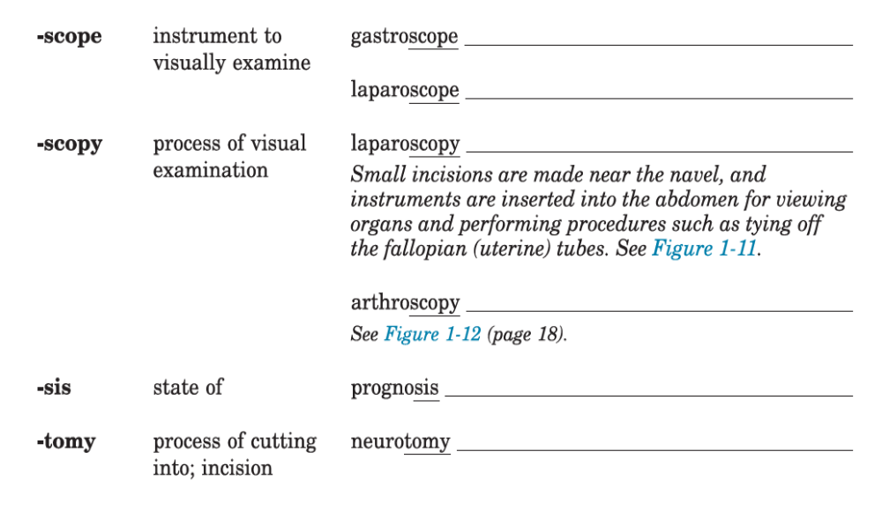

Slide 45
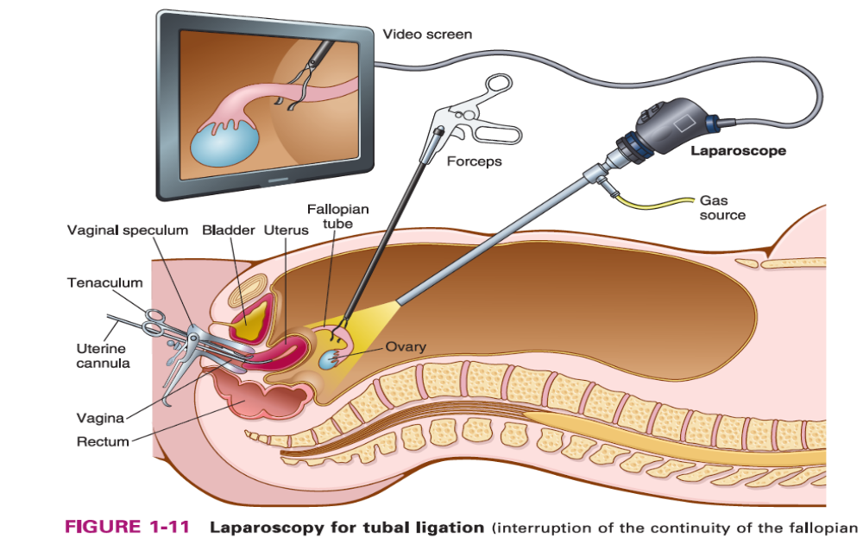

Slide 46
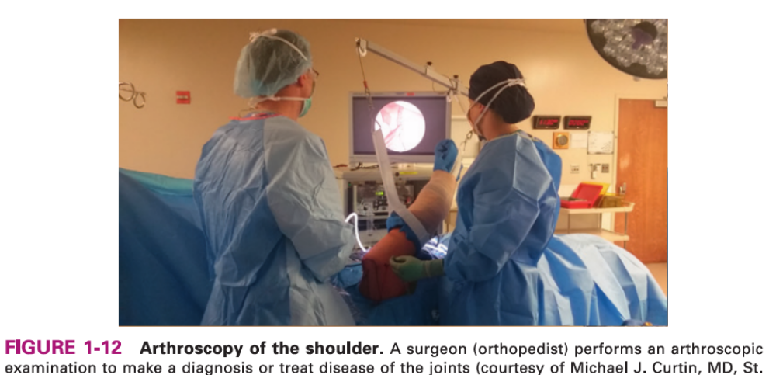

Slide 47
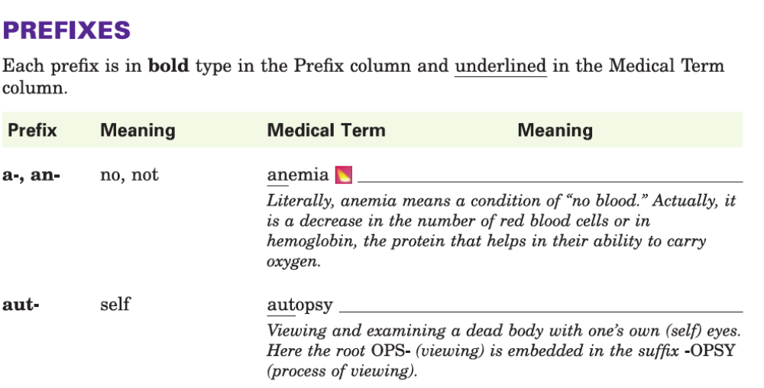


Slide 48
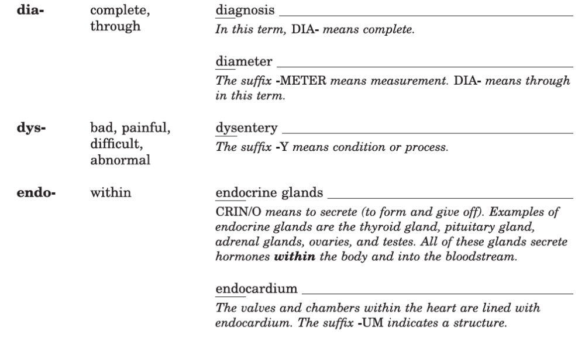

Slide 49
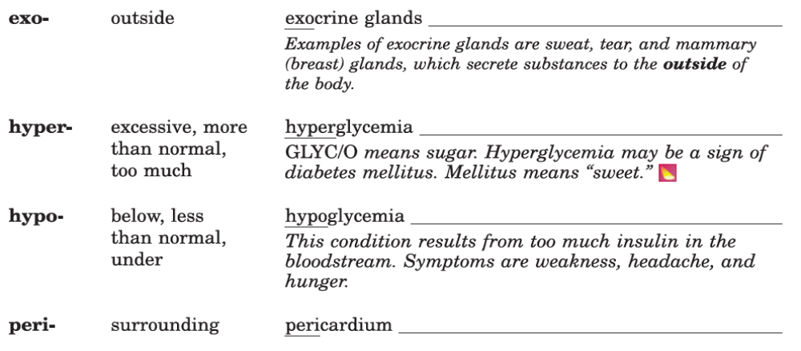

Slide 50
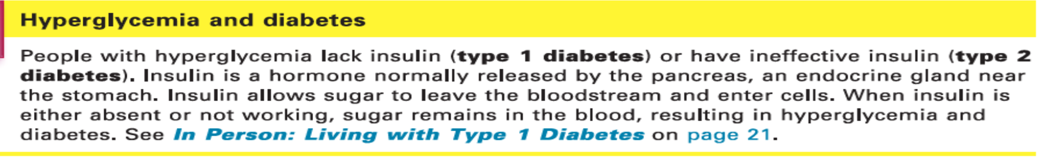

Slide 51
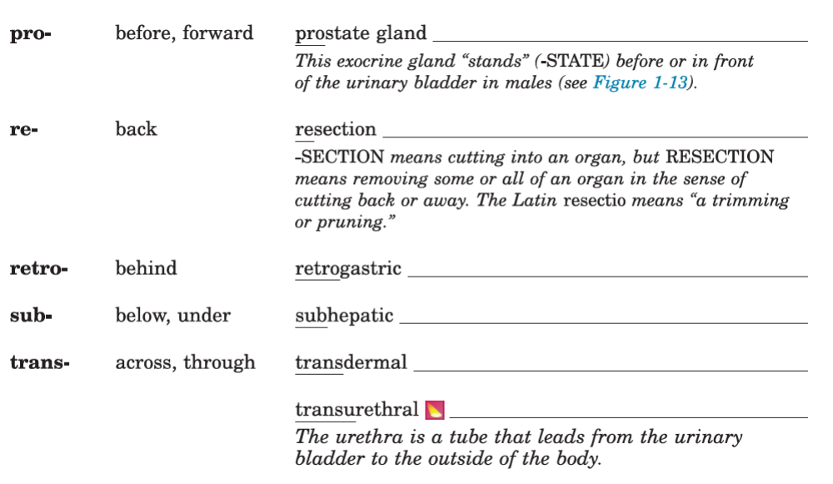

Slide 52
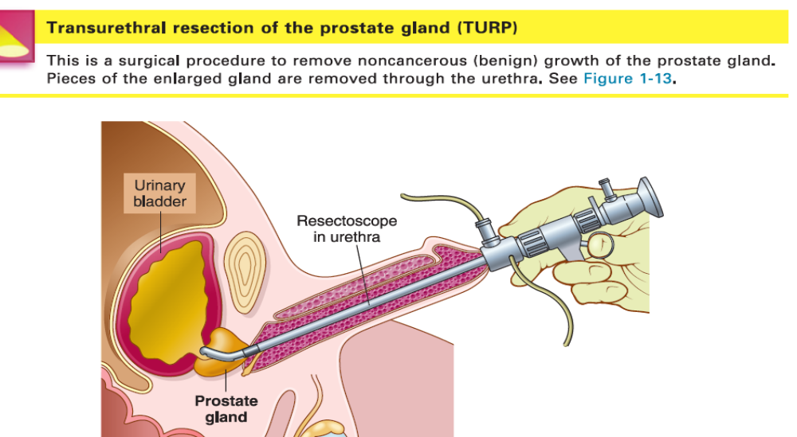

Slide 54
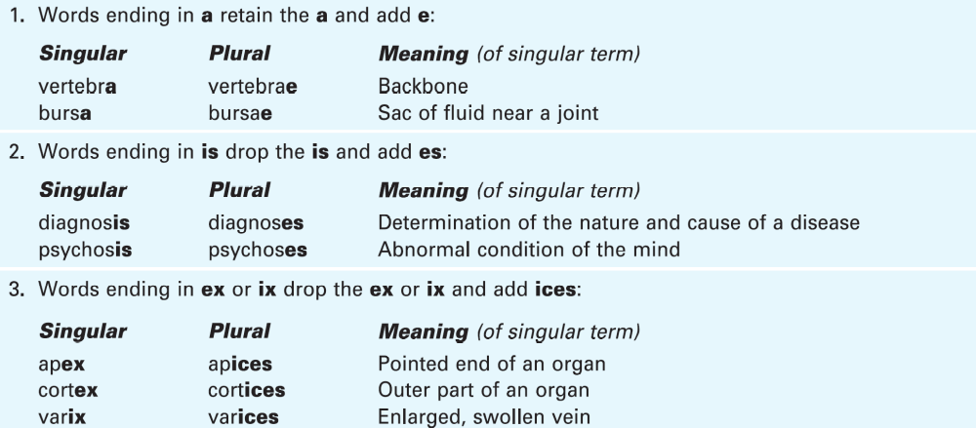

Slide 55
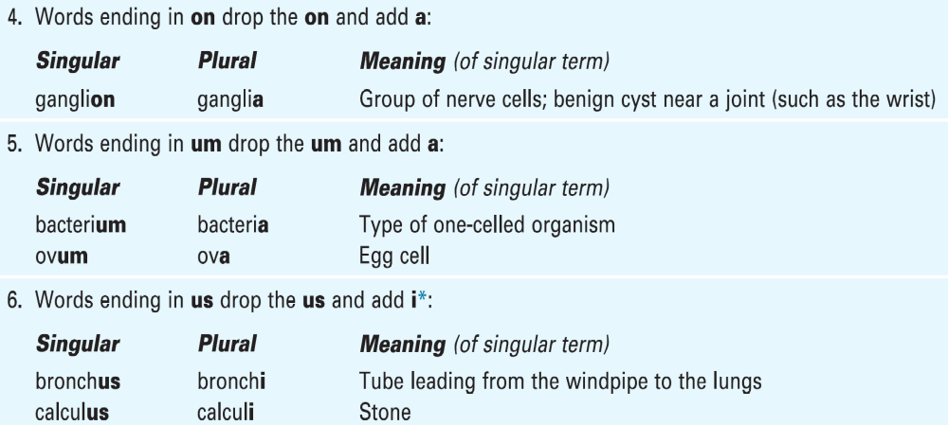

Slide 56
Exercises

Slide 57
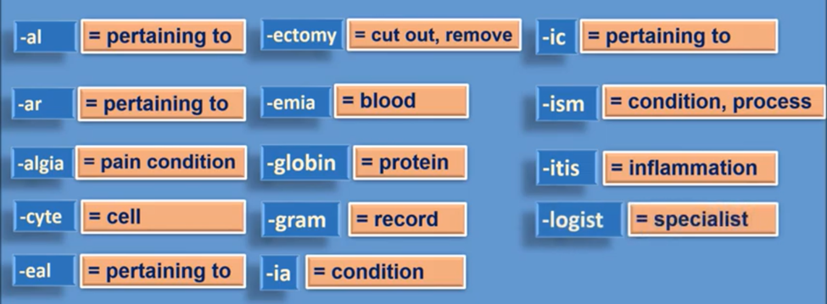
Suffixes

Slide 58
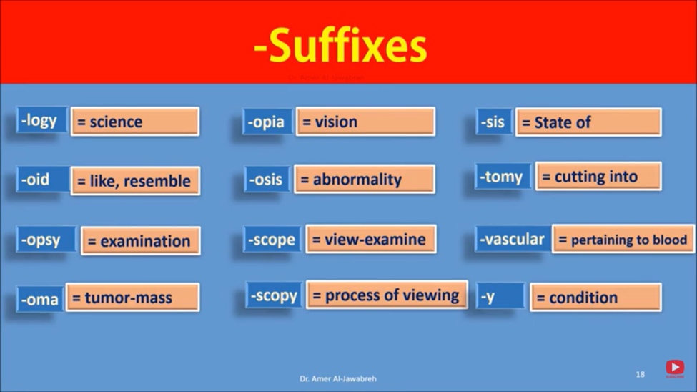
Suffixes

Slide 59
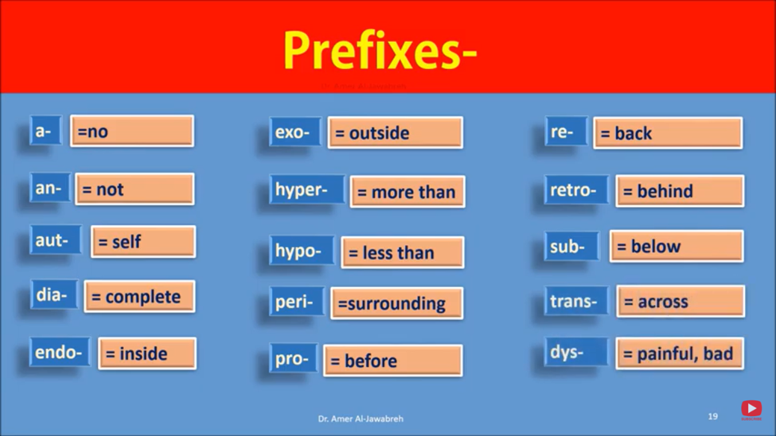
Prefixes

Slide 60
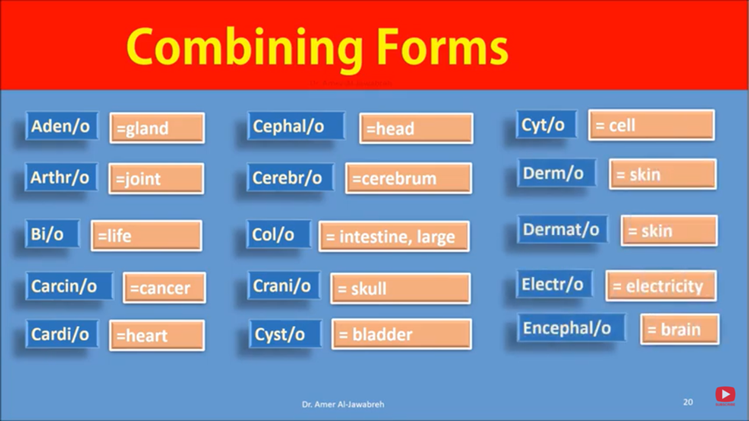
Combining Forms

Slide 61
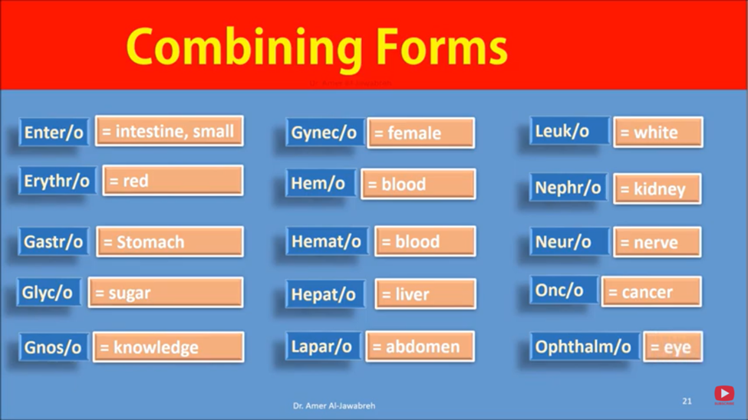
Combining Forms

Slide 62
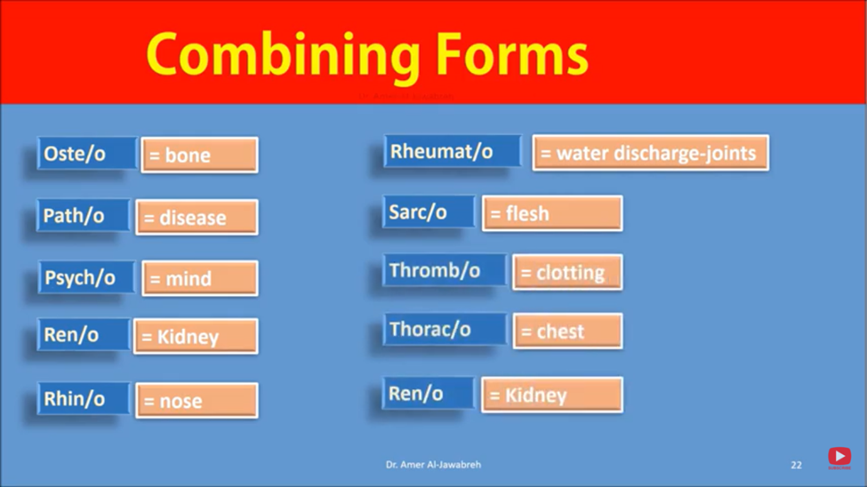
Combining Forms

